Slide 1
International Economics
Student
institution
Notes:
India is the 7th largest country globally with an Area of 3,287,263km². Its land stretches 3214km (south-north) and 2933km (west-east). India’s coastline size is 7516.6km. the country is surrounded by the following Coastal borders: Persian Gulf & Red Sea at the Northern area and Andaman & Arabian seas to the north east and northwest respectively

Slide 2
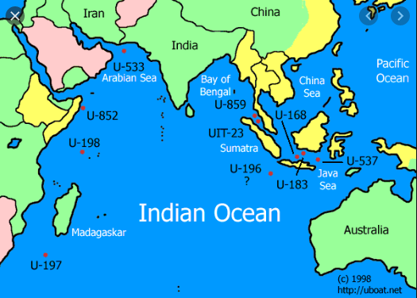
INDIA: Location , Size & Nearby Seas
It is the 7th largest country globally
Area:3,287,263km2
3214km(south-north)
2933km(west-east)
Coastline size:7516.6km
Coastal borders:
Persian: Gulf & Red Sea at the Northern area,
Andaman & Arabian seas to the north east and northwest respectively
Notes:
India is the 7th largest country globally with an Area of 3,287,263km². Its land stretches 3214km (south-north) and 2933km (west-east). India’s coastline size is 7516.6km. the country is surrounded by the following Coastal borders: Persian Gulf & Red Sea at the Northern area and Andaman & Arabian seas to the north east and northwest respectively

Slide 3

India’s Conflict with neighbors
India Neighbors China, Pakistan, Nepal, Afghanistan, Bangladesh & Bhutan.
India’s military was conquered in 1962 in a war with China.
Over 4000 soldiers were killed.
Currently, there are border tensions as both countries have territorial claims.
Notes:
China Neighbors China, Pakistan, Nepal, Afghanistan, Bangladesh & Bhutan. Indians combatted and lost to China in 1962 leaving over 4000 soldier dead. The two countries also fought in 1967 were conquered in 1962 in a war with China. Currently, there are border tensions as both countries have territorial claims.

Slide 4

Indian Population
The population of China stands at 1,385,271,269 people as per Nov UN statistics.
Population is about 17.7% of the global population
It is 2nd most populated country globally
35% of the citizens reside in urban areas
Population density:464/km²
Notes:
The population of China stands at 1,385,271,269 people as per November 2020 UN statistics. This is about 17.7% of the global population. The country is the 2nd most populated country globally. 35% of the citizens reside in urban areas with a population density of 464/km².

Slide 5
Economic Performance, Natural resources, produce and exports
India’s nominal GDP was $2.94 trillion as at the end of 2019.
RBI interest rates stand at 4%
Fifth biggest economy globally
The yearly price inflation has reached 7.61% as per the latest statistics in Oct 2020.
Food rate of inflation reached 11.8% this year.
2019 unemployment rate was 5.36% but it is estimated to reach 5.4% this year.
2020 unemployment rate is 6.70%
India occupies 4th 5th and 7th position regarding the endowment of coal, bauxite, and iron reserves globally.
Natural gas reserves and oil are above 1437 billion m³ and 100million tones respectively.
Milk is the main produce accompanied by jute and pulses
Main country’s exports are mineral fuels, gems, machinery, organic chemicals, pharmaceuticals, iron(steel), textiles, and vehicles
Notes:
India’s nominal GDP was $2.94 trillion as at the end of 2019 but is expected to grow in 2020. the RBI interest rates stand at 4%. This was a decrease from the previous year where it stood at 4.4%.
India is the Fifth biggest economy globally with its inflation rate standing at 7.61% as per the latest statistics of Oct 2020.
The yearly price inflation has reached 7.61% as per the latest statistics in Oct 2020. inflation statistics as per last year showed that the economy was grappling with an 11.8% food inflation rate. The country’s rate of unemployment in 2020 stands at 6.70%. India occupies 4th 5th and 7th position regarding the endowment of coal, bauxite, and iron reserves globally. Natural gas reserves and oil are above 1437 billion m³ and 100million tones respectively.
The main country’s exports are mineral fuels, gems, machinery, organic chemicals, pharmaceuticals, iron(steel), textiles, and vehicles.
Food rate of inflation reached 11.8% this year.
2019 unemployment rate was 5.36% but it is estimated to reach 5.4% this year.
India occupies 4th 5th and 7th position regarding the endowment of coal, bauxite, and iron reserves globally.
Natural gas reserves and oil are above 1437 billion m³ and 100million tones respectively.
Milk is the main produce accompanied by jute and pulses. The main country’s exports are mineral fuels, gems, machinery, organic chemicals, pharmaceuticals, iron(steel), textiles, and vehicles.

Slide 6
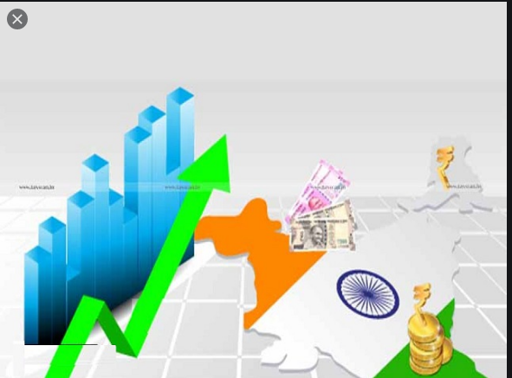
India’s Imports
Main imports: Gold, coal, diamonds, waxes, oils, mineral fuels and bituminous products.
Other imports include nuclear reactors, mechanical and machinery reactors, boilers, jewelry and pearls
Notes:
The Indian imports include Gold, coal, diamonds, waxes, oils, mineral fuels and bituminous products.
Other imports include nuclear reactors, mechanical and machinery reactors, boilers, jewelry and pearls. Oil is the main import followed by precious stones , electronics, machinery, chemicals , plastics, vegetable oil and steel.

Slide 7
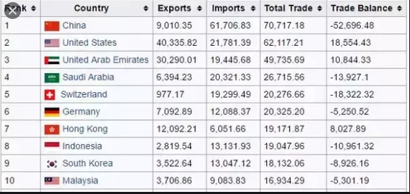
Trading partners
China, the US, the UAE, Saudi Arabia, and Switzerland
India has engaged in a couple of trade agreements with regional blocks like NAFTA, CAFTA,EU,& APEC).
Trade agreement benefits:
enhancement of economic growth and trade
standardization of business operations by leveling the paying ground
tariff elimination as well as other taxes
The countries sign anti-dumping treaties
Elimination of unfair subsidies
labor ideals, regulations and environmental protections are standardized
Trade agreements promote innovation
Notes:
According to the commerce industry, the main Indian partners in trade include China, the US, the UAE, Saudi Arabia, and Switzerland. These are the main countries who engage in the most of the imports from the country. India has engaged in a couple of trade agreements with regiona blocks like the North American Free Trade Agreement (NAFTA), the Central American-Dominican Republic Free Trade Agreement (CAFTA the European Union (EU), and the AsiaPacific Economic Cooperation (APEC)
The benefits of trade agreements include tarrif elimination as well as other taxes hence providing each country participant a trade a price benefit.
The countries sign anti-dumping treaties. Additionally, unfair subsidies are removed especially the ones that negatively affect exportation to other nations.
labor standards, regulations and environmental protections are standardized. Fewer laws act like subsidies hence bolstering exporter’s competitive benefits over overseas rivals.

Slide 8

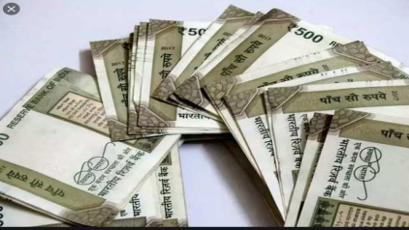
Indian Current & Budget Account: GDP
Current and capital accounts are portions of a government’s payments equilibrium. The formers ratio to the GDP measures a nation’s global competitiveness
India’s Current Account: GDP=0.9% in 2020
India's budget deficit as a fraction of its GDP was around 7.44% and 7.42% in 2020
Budget balance= Government revenue- expenditure
Notes:
Current and capital accounts are portions of a government’s payment balance. The formers ratio to the GDP measures a nation’s global competitiveness.
i current account deficit to GDP ratio was negative 0.9 percent in fiscal
year 2020, up from nearly negative two percent in the previous fiscal year
India's budget deficit as a fraction of its GDP was around 7.44% and 7.42% in 2020
Budget balance= Government revenue- expenditure

Slide 9
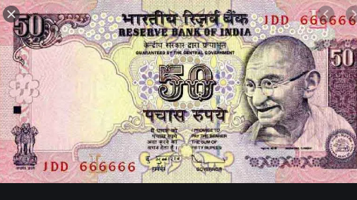
India’s Currency & Exchange rate
The main currency for India is the Rupee
It is the official country’s currency
The current USD:INR=1: 74.1459
The symbol for the currency is ₹
Notes:
The main currency for india is the Rupee (INR) . It has ₹ as the symbol. The current USD:INR=1: 74.1459 as at 22/11/2020
The symbol for the curency is

Slide 10
India Financial Institutions & Public Debt
India’s Financial institutions are denoted as financial instruments
They ensure efficient resource allocation
Act as intermediaries between lenders and borrowers.
FIs are categorized as follows: payment, co-operative, small finance & commercial banks.
India has over 91 banks inclusive of 20 and 19 public and private banks respectively
External debt stood at $558.5billion(march 2020) indicating a 2.8% increase from previous year.
Notes:
India’s financial institutions are denoted as financial instruments. They ensure efficient resource allocation as well as acting as intermediaries between lenders and borrowers. These institutions are categorized as follows: payment, co-operative, small finance and commercial banks. India has over 91 banks inclusive of 20 and 19 public and private banks respectively. Indian external debt stood at $558.5billion(march 2020) indicating a 2.8% increment from last year due to enhanced borrowing attributed by Covid-19 pandemic.

Slide 11

FDIs and Tax Policy
India is a good destination for FDI due to:
low wages
Tax exemptions
Indian shareholders in an FDI are taxed more than foreigners
The first Rs.250000 is not taxed from a foreign company.
Favorable working environment
Flexed FDI norms in power exchanges, telecom, stock exchange, oil refineries promote FDIs.
Notes:
India is a good destination for FDI due to availability of cheap labor, dynamic economic environment, low wages, and tax exemptions. The first Rs.250000 from an FDI income is not taxable. Again foreign shareholders pay fewer taxes on their income than Indian investors. Their taxation ratio is 20:42.7. The country has also more recently flexed FDI norms in power exchanges, telecom, stock exchange, oil refineries promote FDIs. This makes the country a very ample investment ground for foreigners.

